Slide 1
The Story of Everything
History of Biological Diversity
Part 1
Part 2
Part 3
Part 4
Part 5
Part 6
Common Traditions
Scientific Theories
Timeline of the Story
The Phanerozoic Eon
Patterns of Evolution
Human Evolution

Slide 2
The Story of Everything
History of Biological Diversity
Part 1 Common Traditions

Slide 3
Demarcation of Science Nature of Scientific Knowledge
Remember our lessons on the nature of science. Philosophy of science attempts to study the relationships between science, pseudoscience, and non-science. Identifying the boundaries between domains of knowledge is called DEMARCATION, and is sometimes considered one of the central questions of science.
Non-scientific domains of knowledge exist. The label “non-science” does not mean “untrue.” Rather, there are ideas and beliefs that cannot be tested by the methods of science. There are limitations to what science theories can explain.
Science, religion, cultural traditions, and philosophies are not mutually exclusive. All these seek to understand our existence and assist us in living our human lives, but from different perspectives.

Slide 4
Demarcation of Science Nature of Scientific Knowledge
Tree of Knowledge Review

Slide 5
Common Traditions Culture, Philosophy, and Religion
Throughout history , human cultures and civilizations have formed stories to explain the origin of the world and life upon it. It can be fascinating to compare these.
These creation stories demonstrate remarkably intelligent observations of our surroundings and natural phenomena, often agreeing more closely to scientific theories than many people are aware.
Great caution must be used in discussing these ideas to avoid offence to any group. Very broad ideas will be reviewed solely for the purpose of general comparison with scientific theories (demarcation).
Neither promotion nor criticism of any belief system will be allowed in this lesson.

Slide 6
Common Traditions Culture, Philosophy, and Religion
Classic Elements of Nature (Greek Tradition) – These have become such an embedded part of Western language and culture that the ideas continue to influence how we think, even in science and religion. They represent categories of substances or divisions of nature.
Fire
Earth
Wind
Water
Aether “breath of life”

Slide 7
Common Traditions Culture, Philosophy, and Religion
Many traditions suggest a common order to major events in Earth’s history:
1. Formation of the Earth
2. Life appeared in the Oceans
3. Life appeared on Land
4. Humankind is new

Slide 8
The Story of Everything
History of Biological Diversity
Part 2 Scientific Theories

Slide 9
Scientific Theories Cosmology and Planetary Science
Empirical evidence from astronomy, geology, and the study of the fossil record suggest a similar order of major events in Earth’s history:
1. Formation of the Earth
2. Life appeared in the Oceans
3. Life appeared on Land
4. Humankind is new

Slide 10
Scientific Theories Cosmology and Planetary Science
Let’s now study the scientific evidence and theories about the development of the Universe, Earth, and life.

Slide 11
Scientific Theories Essential Vocabulary
Important Latin & Greek Words:
Sol = Sun | Terra = Earth | Luna = Moon | Astron = Star | Celeste/Heaven = Sky
World - from OE woruld or worald having three connotations: (1) "human existence, the affairs of life," (2) "a long period of time," and (3) the "human race, mankind, humanity." Descended from Norse and Germanic words warld, verold, weralt, welt which mean "age of man"
Cosmos - from Greek kosmos which means "orderly arrangement" but evolved to mean "the world of mankind" and then to mean "the universe"
Planet - from Greek planitas (these are often called "spheres")
Universe - from Latin universum which means "all things, everybody, the whole world"
Theory - an explanation of natural object and phenomena based on strong evidence that has been reviewed and confirmed by many scientific peers
Evolution - from Latin evolvere "to unroll, roll out, roll forth, unfold" which has evolved to mean "change, growth"

Slide 12
Scientific Theories Empirical Evidence
LAYERS OF EVOLUTION
Cosmic Evolution (universe)
Galactic Evolution
Stellar Evolution
Planetary Evolution
Biological Evolution

Slide 13
Scientific Theories Empirical Evidence
EVOLUTION OF THE UNIVERSE
Telescopic Astronomy & Spectroscopy
Red/Blue Shift & Universal Expansion
Big Bang Energy Dissipation & CBMR
Universal Abundance of Elements
Olber’s Paradox

Slide 14
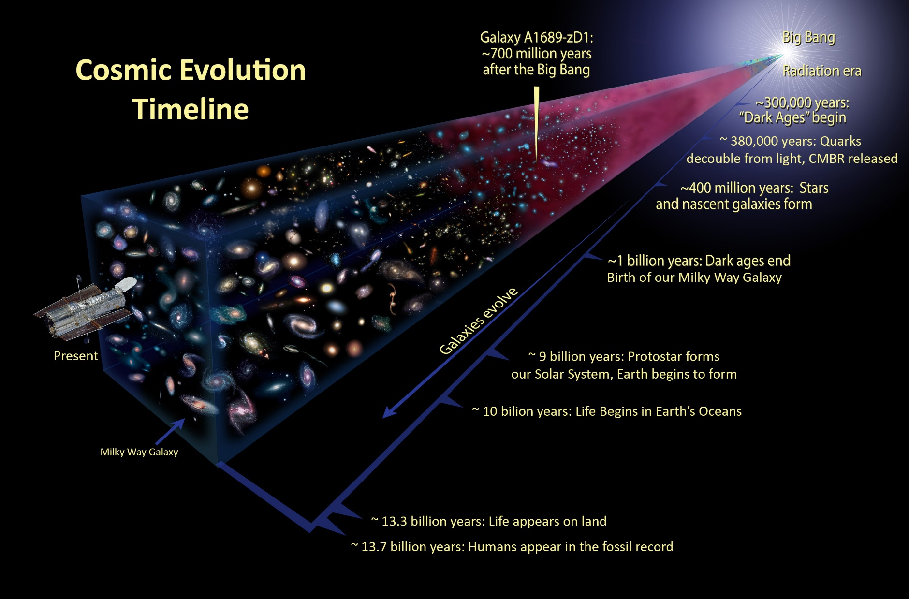
What is the future of our Universe?

Slide 15
Scientific Theories Empirical Evidence
EVOLUTION OF GALAXIES & STAR SYSTEMS
Telescopic Astronomy & Spectroscopy
Nebular Theory - Gravitational Condensation of H₂ and He
Stellar Fusion & Generation of Heavier Elements
Recycling of Matter and Energy

Slide 16
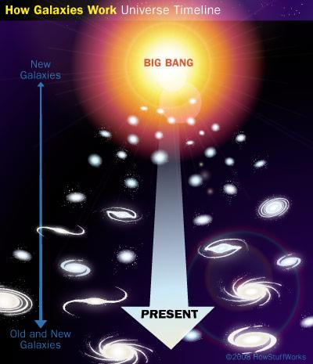

Slide 17
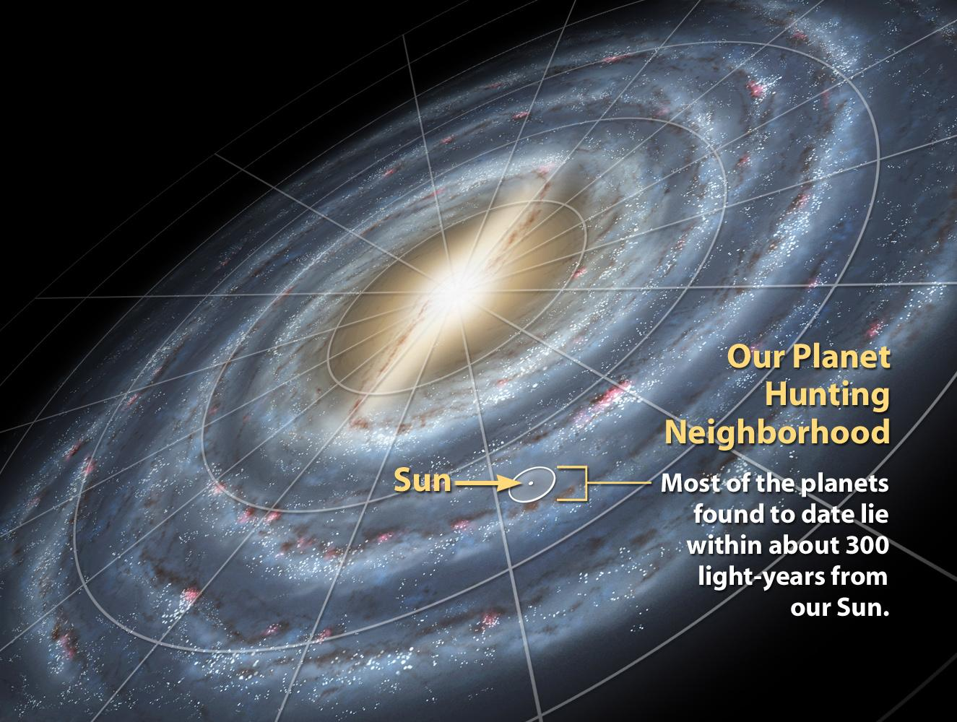
Our Milky Way Galaxy

Slide 18
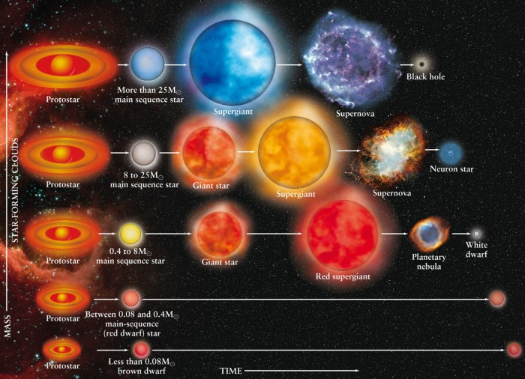
Stellar
Life Cycles
Sol

Slide 19
Scientific Theories Empirical Evidence
EVOLUTION OF PLANETS
Stellar disks & planetary accretion
Plate tectonics
Sea level cycles and ice caps/glaciers
Geologic core samples of rock
Polar core samples of ice

Slide 20
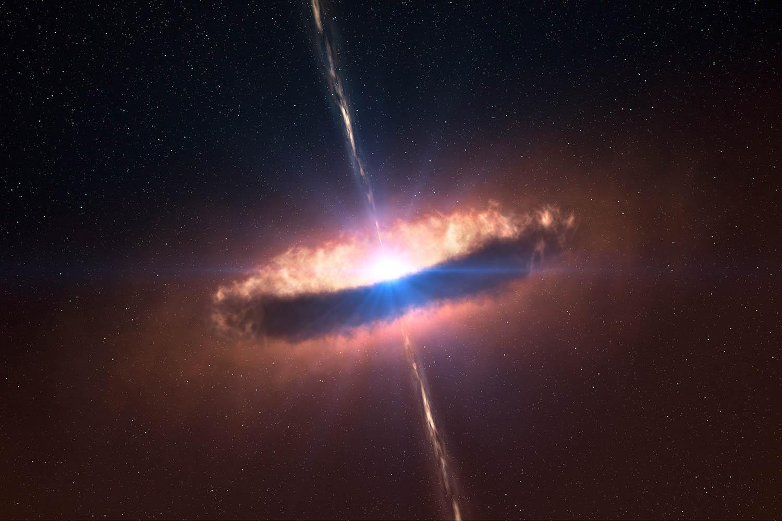
Nebular Theory: Birth of a Star
Nuclear fusion ignited by gravitational pressure at center of accretion disk

Slide 21
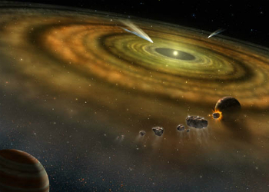
baby star
Orbiting dust particles gather by gravity into rings that accrete into planets

Slide 22
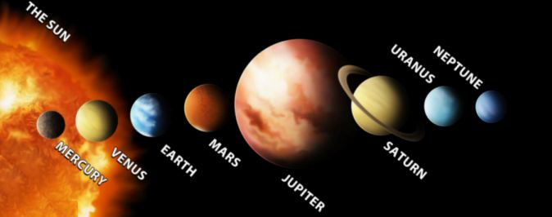
Our Stellar System - Sol

Slide 23
Scientific Theories Empirical Evidence
EVOLUTION OF LIFE
Fossils & Age Dating – relative vs. radiometric
Comparative Anatomy
Comparative Embryology
Comparative Biochemistry
Geographic Distribution of Species
Phylogenetics (DNA code similarities)

Slide 24
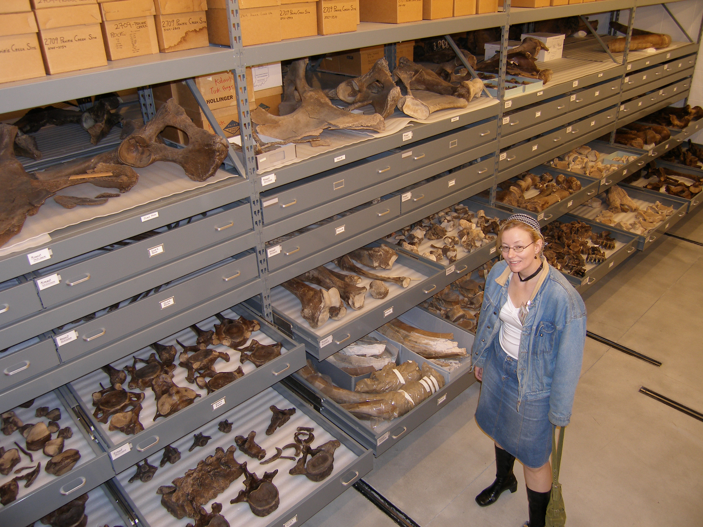
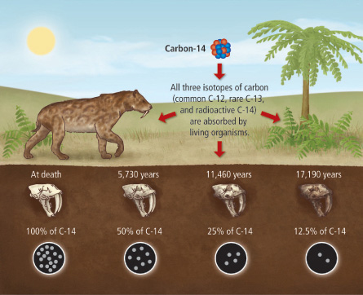
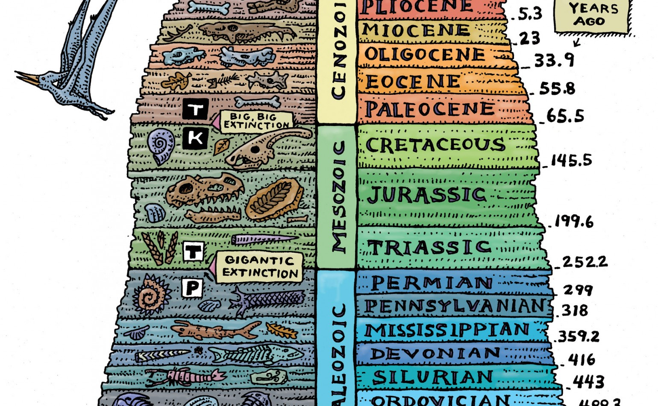
Biological Evolution Empirical Evidence
Fossils & Age Dating
Comparative Anatomy
Comparative Embryology
Comparative Biochemistry
Geographic Distribution
Phylogenetics
Relative Age Dating
Radiometric Age Dating
Fossil Records - Largest Natural History Museums in the US

Slide 25
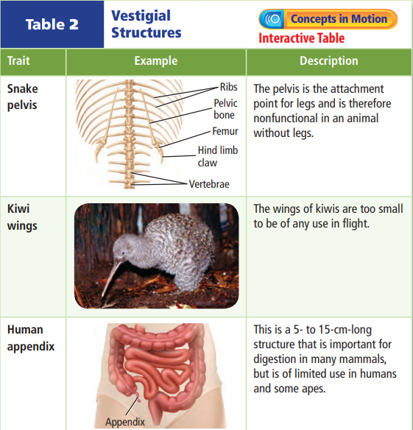
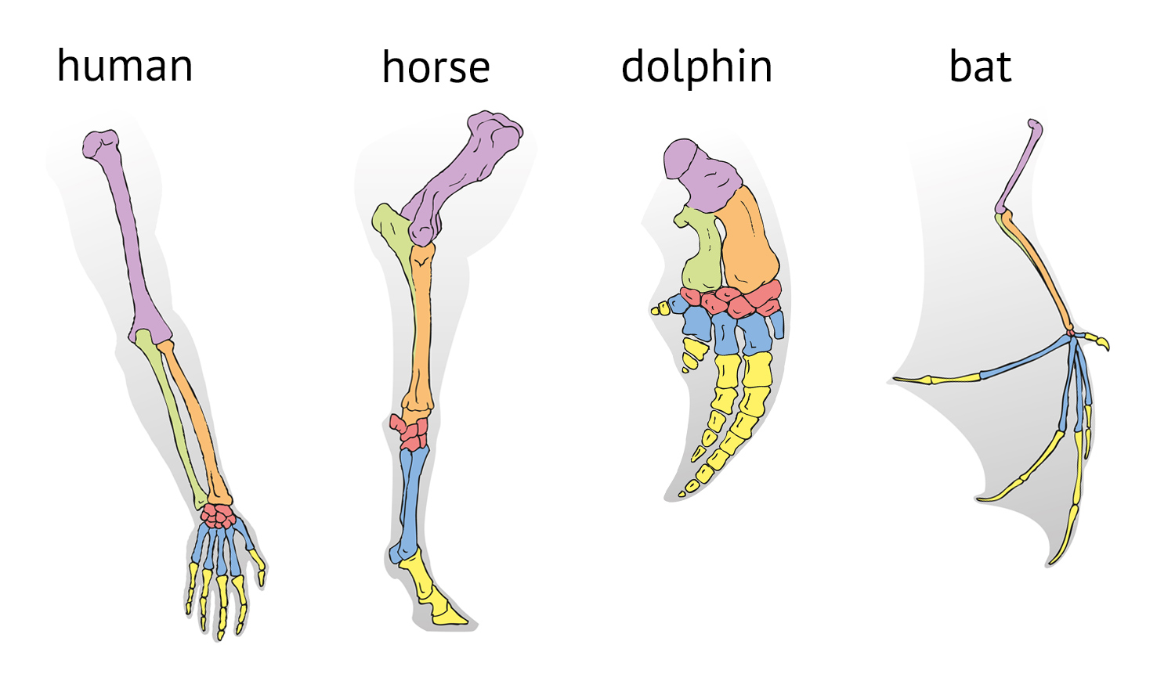
Biological Evolution Empirical Evidence
Fossils & Age Dating
Comparative Anatomy
Comparative Embryology
Comparative Biochemistry
Geographic Distribution
Phylogenetics
Example 1: Mammal limbs follow the pattern of 1 bone, 2 bones, many bones, phalanges. The patten is coded in DNA shared by all these species. Example 2: Vestigial Structures.

Slide 26
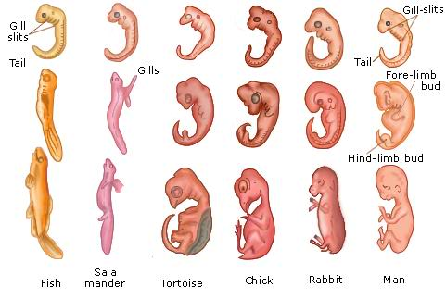
Biological Evolution Empirical Evidence
Fossils & Age Dating
Comparative Anatomy
Comparative Embryology
Comparative Biochemistry
Geographic Distribution
Phylogenetics
Early embryos of many animal species look very similar. Notice all the following have eyes on the sides, gill slits, and a swimming tail. Additional DNA “programming” further modifies this body plan.

Slide 27
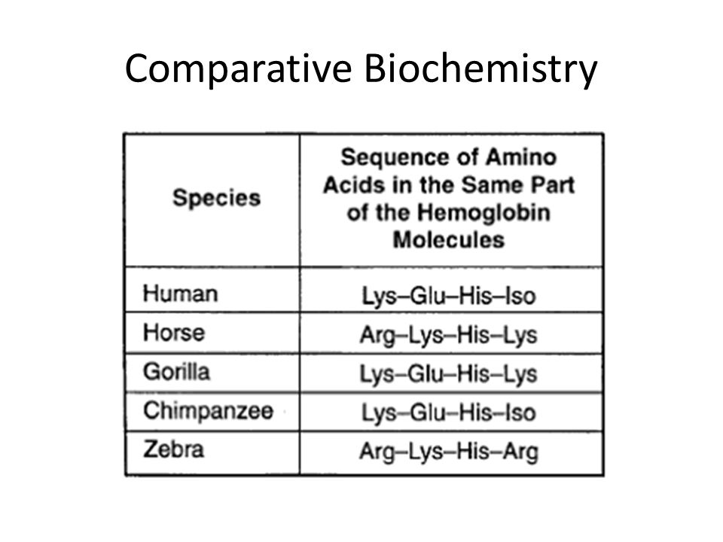
Biological Evolution Empirical Evidence
Fossils & Age Dating
Comparative Anatomy
Comparative Embryology
Comparative Biochemistry
Geographic Distribution
Phylogenetics

Slide 28
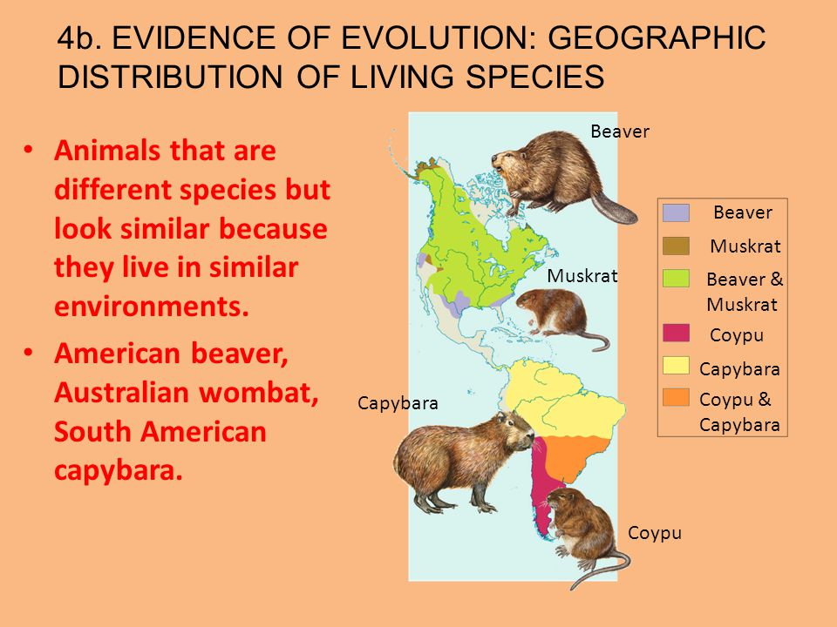
Biological Evolution Empirical Evidence
Fossils & Age Dating
Comparative Anatomy
Comparative Embryology
Comparative Biochemistry
Geographic Distribution
Phylogenetics

Slide 29
Biological Evolution Empirical Evidence
Fossils & Age Dating
Comparative Anatomy
Comparative Embryology
Comparative Biochemistry
Geographic Distribution
Phylogenetics

Slide 30
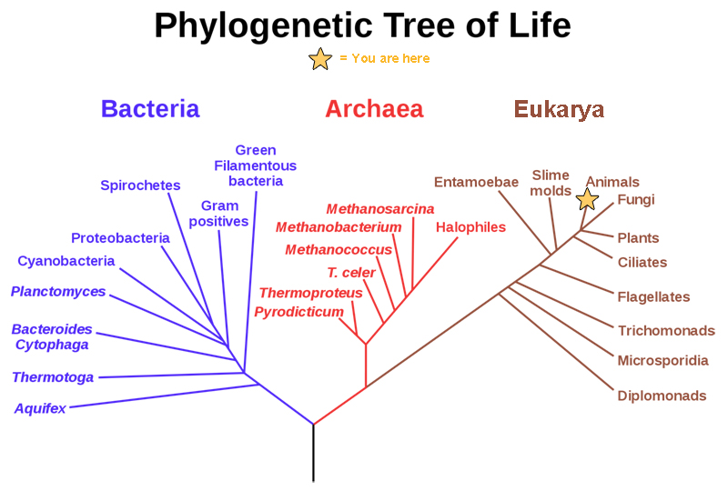
Scientific Theories Biological Evolution - Tree of Life
This is a simplified version of the phylogenetic tree of life based on genetic analysis (% DNA Similarities). The branches indicate close genetic relationships between species.

Slide 31
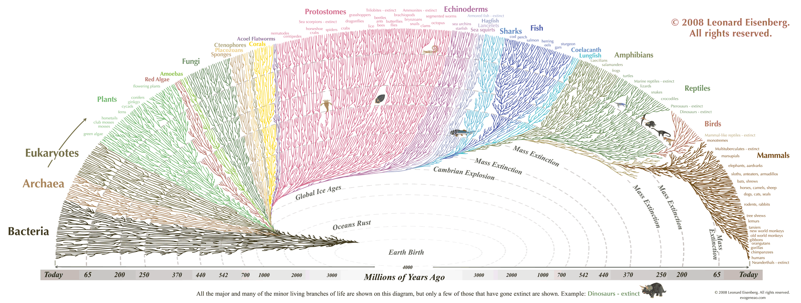
Scientific Theories Biological Evolution - Tree of Life
The Evogeneao Tree of Life diagram is an illustration of the principle that we are genetically related to every species that has ever lived on Earth. Click on diagram to link to the Evogeneao interactive website.

Slide 32
Scientific Theories Empirical Evidence
Review: LAYERS OF EVOLUTION
Cosmic Evolution (universe)
Galactic Evolution
Stellar Evolution
Planetary Evolution
Biological Evolution

Slide 33
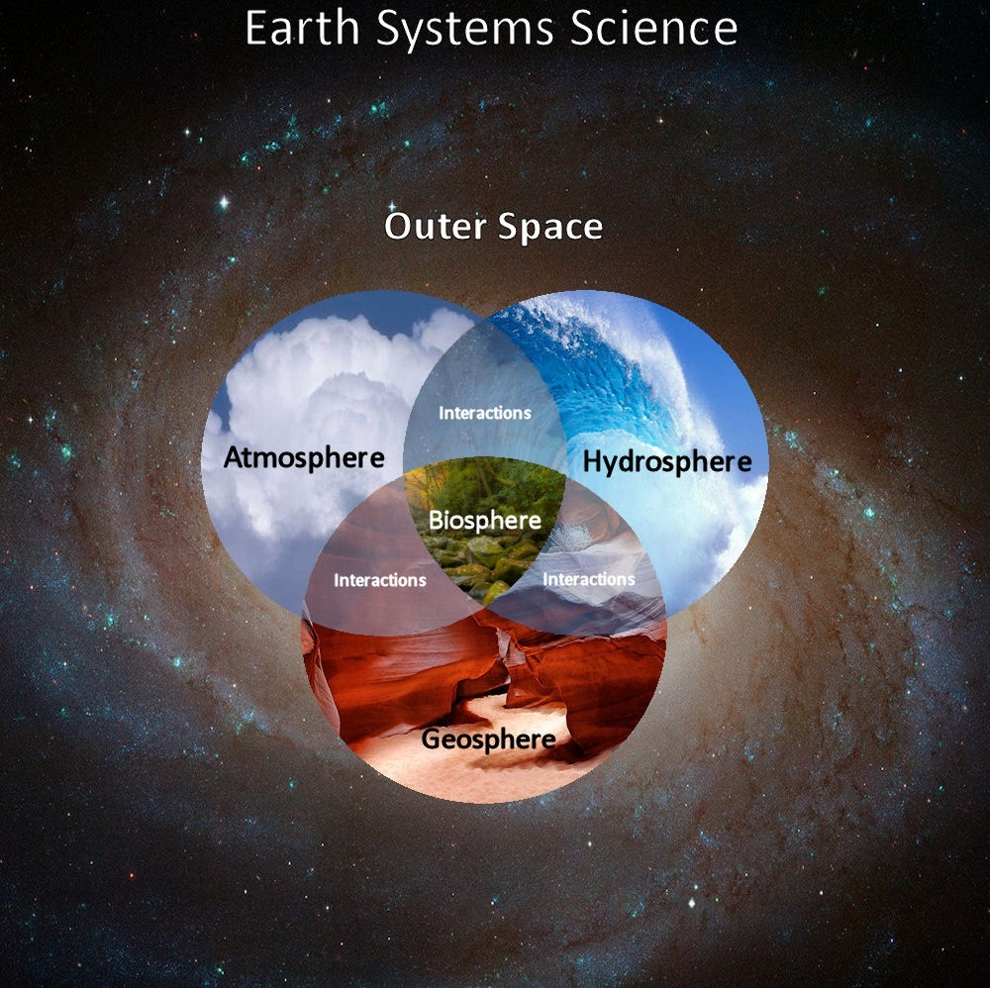
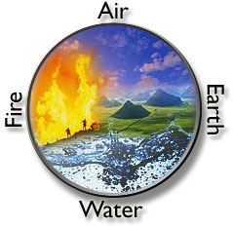
Scientific Theories Systems Theory of Everything
What makes a planet capable of supporting the evolution of life?

Slide 34
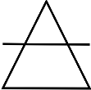
Scientific Theories Systems Theory of Everything
INGREDIENTS FOR A LIVING PLANET (Similarity to Classic Greek Elements)
Stable Source of Energy (Fire)
Active Geosphere (Earth)
Active Hydrosphere (Water)
Active Atmosphere (Air)
Balanced Biosphere (Life)

Slide 35
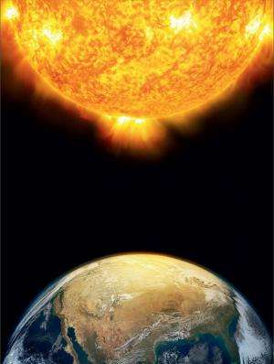
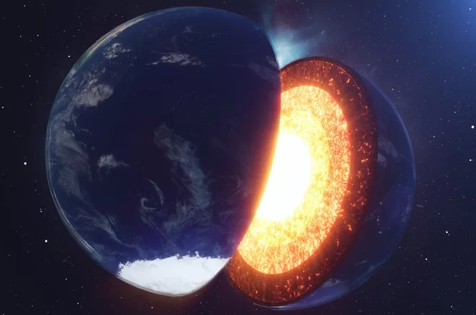
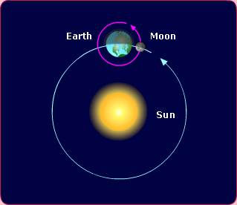
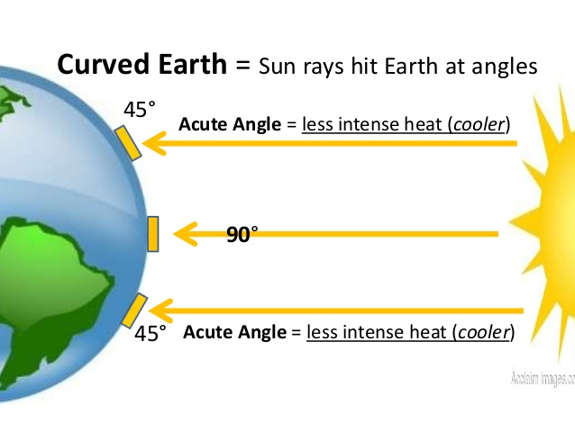
Scientific Theories Cycling of Matter and Energy
Energy Sources and Interactions
1. Solar Energy (Radiation, Light, Heat)
2. Earth’s Hot Core (Radiation/Gravity)
3. Gravity (Sun-Earth-Moon System - Seasons)
4. Uneven Heating of Materials
∙ Climate Zones (Curvature Surface)
∙ Convection (Air, Land, Sea, Core)

Slide 36
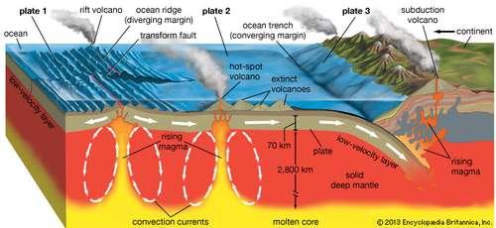
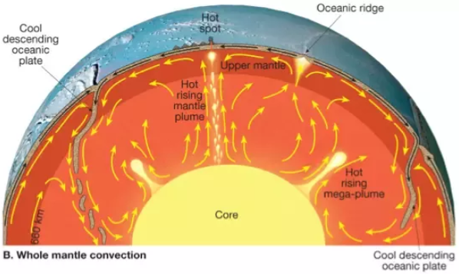
Scientific Theories Cycling of Matter and Energy
Geosphere
1. Convection Currents in the Mantle (Magma)
2. Volcanic Activity
3. Plate Tectonics
4. Rock Cycle

Slide 37
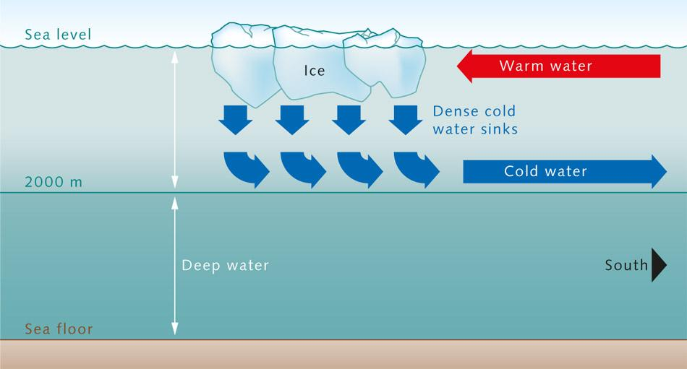
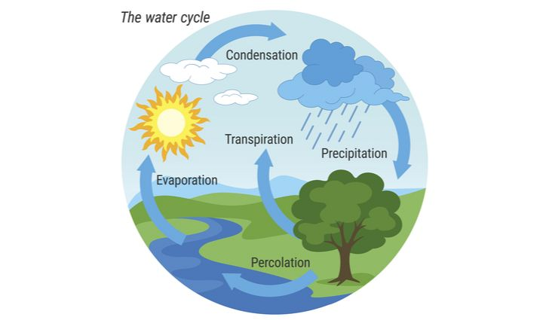
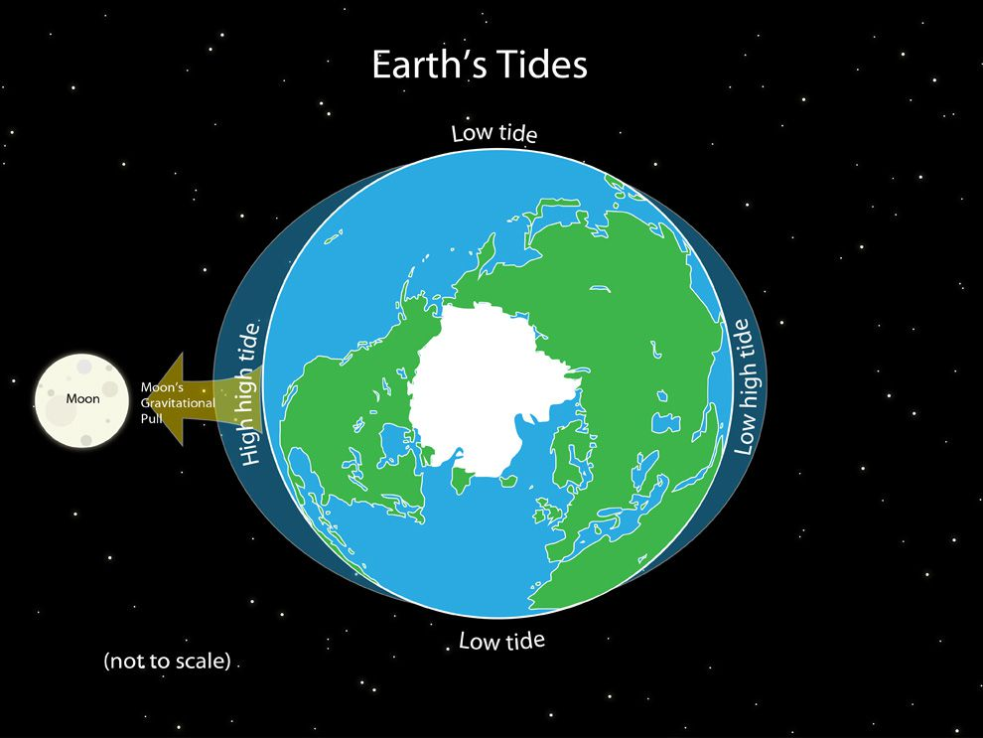
Scientific Theories Cycling of Matter and Energy
Hydrosphere
1. Deep Ocean Currents (Convection)
2. Surface Ocean Currents (Prevailing Winds)
2. Tides (Gravity of Sun and Moon)
3. Water Cycle
a. Evaporation, Condensation, Precipitation
b. Surface and Groundwater
c. Polar Ice Caps

Slide 38
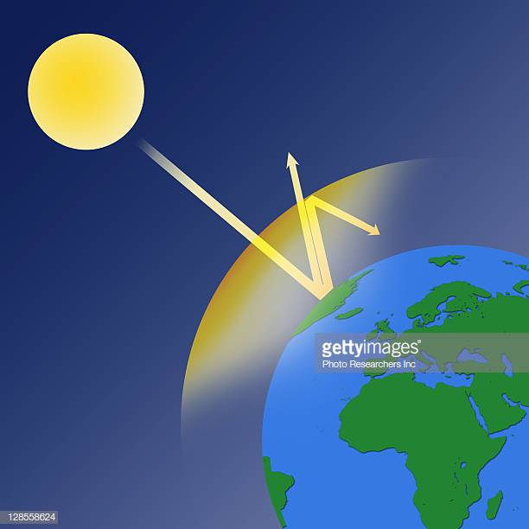
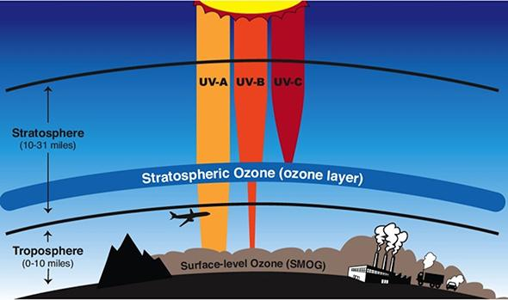
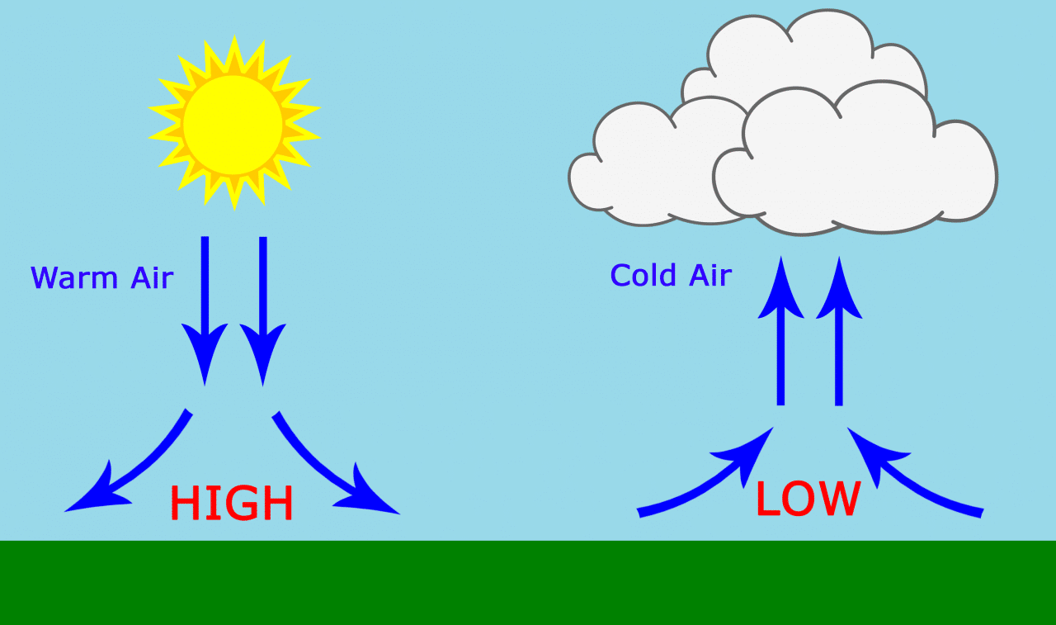
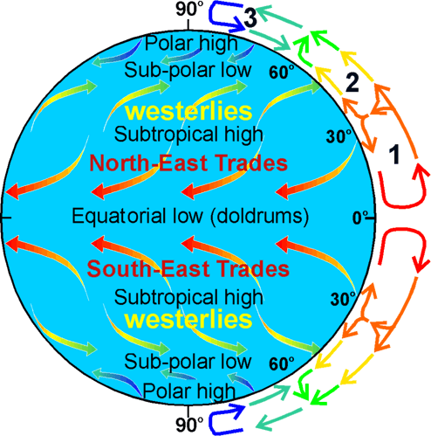
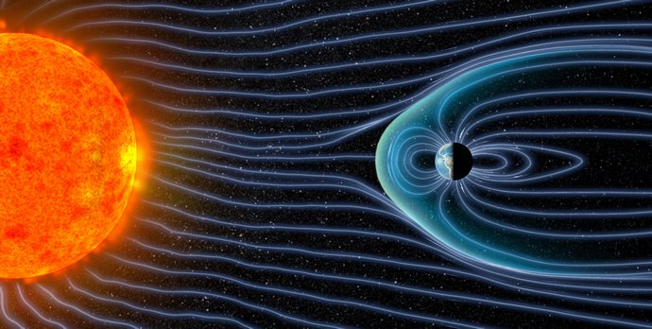
Scientific Theories Cycling of Matter and Energy
Atmosphere
1. Air Currents (Convection, Coriolis Effect)
2. Weather (Air Pressure, Precipitation, Temperature)
3. Climate (Average Weather)
4. Greenhouse Effect (Thermal Shield)
5. Ozone Layer (Radiation Shield)
6. Magnetic Field (Magnetic Shield)

Slide 39
Scientific Theories Cycling of Matter and Energy
Biosphere
1. Biogeochemical Cycles ( H₂O, O₂ , CO₂ , N₂, S, P )
2. Cycles of Environmental Change,
Evolution, Adaptation, and Extinctions
3. Balanced Ecosystems
4. Population Dynamics
5. Trophic Levels, Food Webs, and Energy Pyramids

Slide 40
The Story of Everything
History of Biological Diversity
Part 3 Timeline of the Story

Slide 41
Cosmic Timeline Divisions and Units of Measure
Eons
1,000’s of Millions of Years
Eras
100’s of Millions of Years
Periods
10’s of Millions of Years
Epochs
Millions of Years

Slide 42
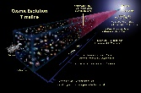
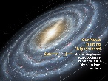
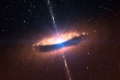
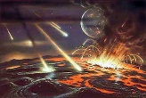
Cosmic Timeline Eons of Cosmic History
Cosmic Evolution
Galactic Evolution
Solar Evolution
Terran (Geologic) Evolution
Biological Evolution

Slide 43
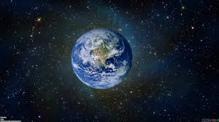
Geologic Timeline Eons of Earth’s History
Hadean
1 Billion Years
Archean
1 Billion Years
Proterozoic
2 Billion Years
Phanerozoic
½ Billion Years

Slide 44
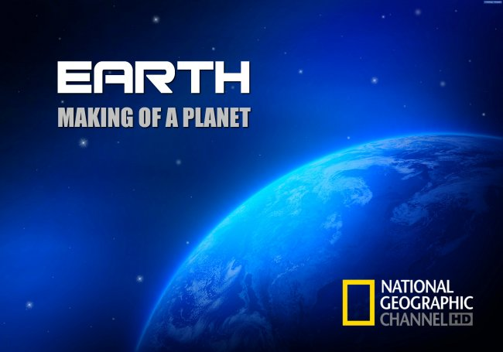
Geologic Timeline Eons of Earth’s History
Hadean Eon
Archean
Proterozoic
Phanerozoic
Video: Earth – Making of a Planet

Slide 45
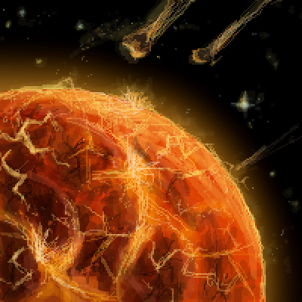
Geologic Timeline Eons of Earth’s History
Hadean Eon
Archean
Proterozoic
Phanerozoic
· Means “Hell on Earth”
· Began ~ 4.5 Billion Years Ago
· Lasted ~ 1 Billion Years
· Key Evolutionary Events:
· Birth of Solar System & Accretion of Planets
· Theia Event – Formation of the Moon
· Cooling Global Temperatures: Resulted in 1st Atmosphere, Solid Crust Forms, Oceans Fill, Continents Begin to Rise and Drift

Slide 46
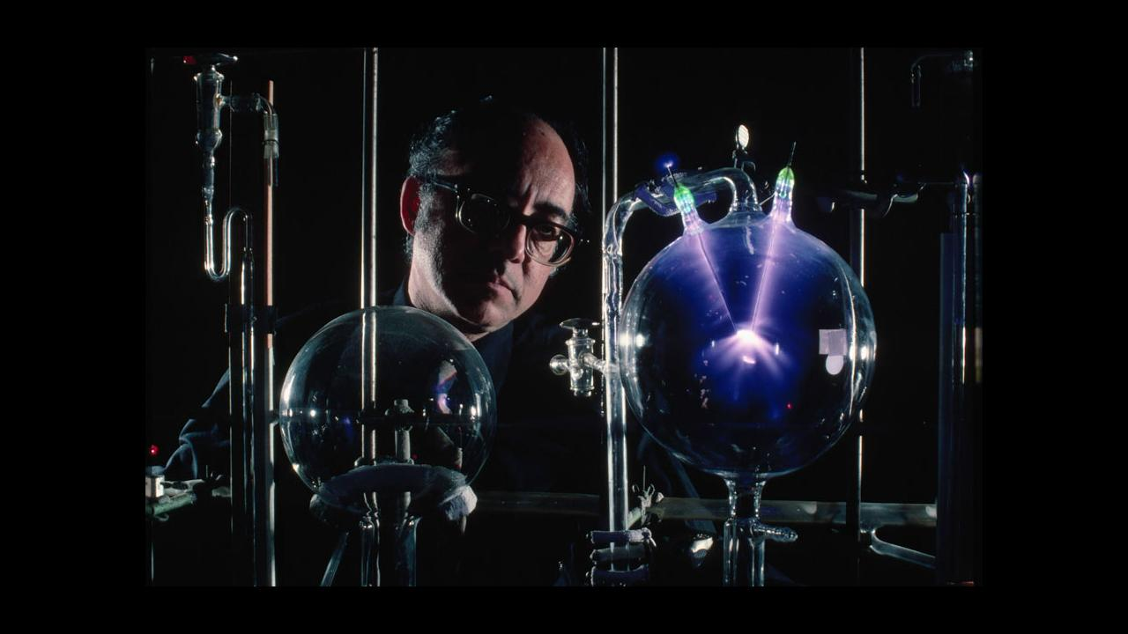
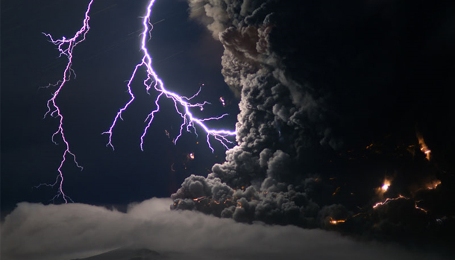
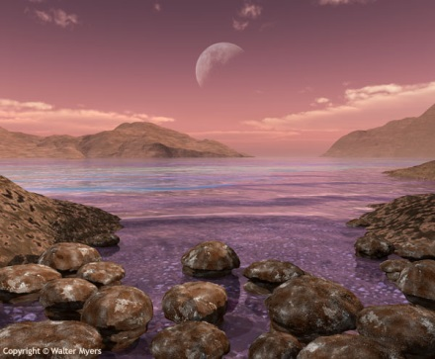
Geologic Timeline Eons of Earth’s History
Hadean Eon
Archean
Proterozoic
Phanerozoic
· Means “Beginning or Origin” of Life
· Began ~ 3.8 Billion Years Ago
· Lasted ~ 1 Billion Years
· Major Evolutionary Events Include:
· Natural development of organic molecules (building blocks of cells) in shallow pools.
· First Single Cell Prokaryotes Appear
· Beginning of Chemo- and Photosynthesis

Slide 47
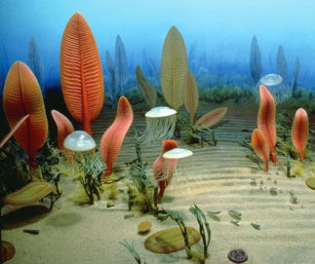
Geologic Timeline Eons of Earth’s History
Hadean Eon
Archean
Proterozoic
Phanerozoic
· Means “Earlier Life”
· Began ~ 2.5 Billion Years Ago
· Lasted ~ 2 Billion Years
· Major Evolutionary Events Include:
· Snowball Earth Event
· Great Oxygenation Event
· Early Multicellular Forms of Life (Eukaryotes)

Slide 48
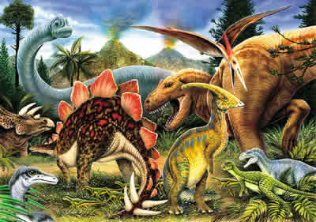
Geologic Timeline Eons of Earth’s History
Hadean Eon
Archean
Proterozoic
Phanerozoic
· Means “Visible Life”
· Began ~ ½ Billion Years Ago
· This is Our Eon of Time, It is Ongoing
· Cambrian Explosion – Diversity of Species
· Advanced Plants and Animals in Oceans
· Migration of Life to Land

Slide 49
The Story of Everything
History of Biological Diversity
Part 4 Phanerozoic Eon
The most recent ½ billion years...

Slide 50
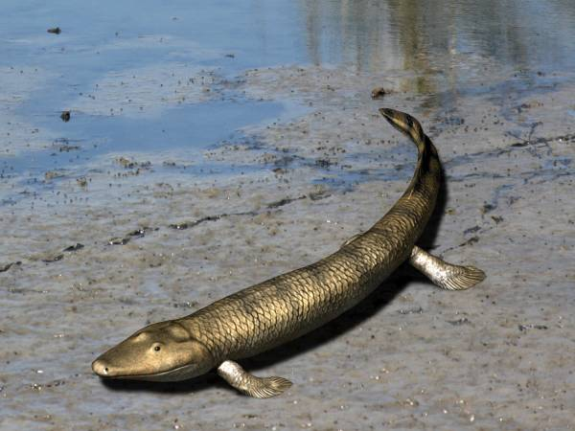
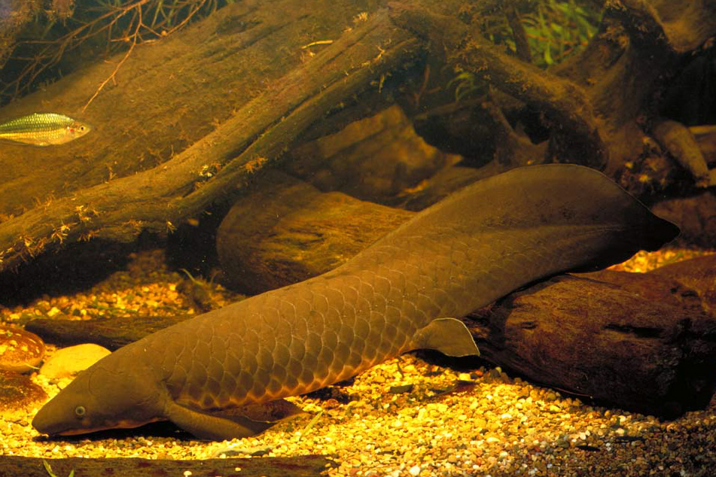
PHANEROZOIC EON
Paleozoic Era
Mesozoic Era
Cenozoic Era
Means “old life”
Began about 541 Mya
Major Evolutionary Events Include:
Cambrian Explosion in # of Species
Jaw Structures & Endoskeletons in Fish
CNS + Eyes, Vertebral Column
Tetrapods Migrate to Land (Video)
Plant Life Migrates to Land
(Vascular Tissue, Spores in Ferns)
Amphibians Evolve and Dominate on Land
Reptiles & Amniotic Eggs Evolve on Land
Arthropods Migrate to Land
(Insects Dominate LIfe on Land)
Mammal-Like Reptiles Appear
Wings in Insects
Plants Evolve Seeds
Paleozoic Era Ended in Mass Extinction – 95% of All Species

Slide 51
PHANEROZOIC EON
Paleozoic Era
Mesozoic Era
Cenozoic Era
Means “middle life”
Began about 251 Mya
Major Evolutionary Events Include:
Conifer Forests Spread
Birds Appear
First Mammals & Dinosaurs Appear
Flying Reptiles
Turtles, Frogs, Lizards, and Salamanders Appear
Flowers and Fruit in Plants
Dinosaurs Dominate on Land
Reptiles Dominate in Oceans
Mesozoic Era Ended in Mass Extinction – Asteroid Strike – 50%

Slide 52
PHANEROZOIC EON
Paleozoic Era
Mesozoic Era
Cenozoic Era
Means “new life”
Began about 66 Mya
Major Evolutionary Events Include:
Mammals Survive and Dominate
Flowering Plants Dominate
Grasses Appear and Spread
Four Major Glaciation Periods
· Extinction of Large Mammals
· Rapid Changes in Marine Species
Several Species of Humans Appear and Go Extinct

Slide 53
The Story of Everything
History of Biological Diversity
Part 5 Patterns of Evolution

Slide 54
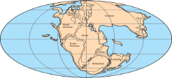
Patterns of Evolution Geological
Continental Drift and Supercontinents
Ur (Vaalbara)
~ 3.6 Gya (Archean)
Kenorland
~ 2.7 Gya (Archean)
Columbia (Nuna)
~ 1.8 Gya (Proterozoic)
Rodinia
~ 1.3 Gya (Proterozoic)
Pannotia
~ 600 Mya (Proterozoic)
Pangaea
~ 300 Mya (Phanerozoic)

Slide 55
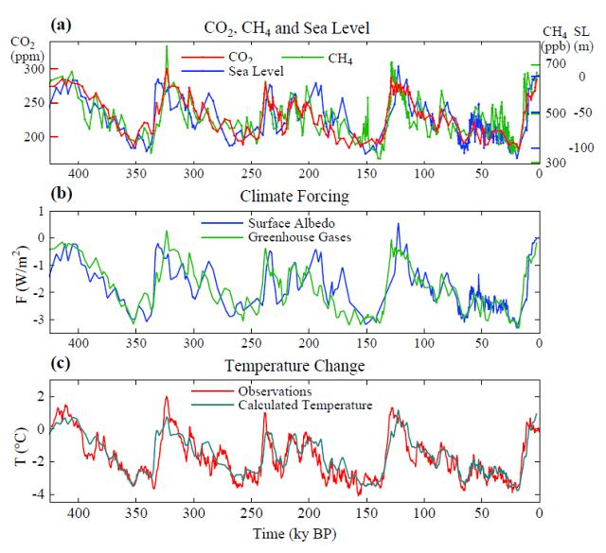
Patterns of Evolution Geological
Global Warming/Cooling
Glaciers and Polar Ice Caps
Changes in Sea Level
Ice Ages

Slide 56
Patterns of Evolution Biological
Environmental Changes & Mass Extinctions
Genetic Mutations
1. Random and Require Many Generations
2. Most Mutations are Deadly – Lead to Extinction
3. Diversification in Anatomy and Physiology
4. Diversification in Size
5. Best Adaptations Passed On to Posterity

Slide 57
The Story of Everything
History of Biological Diversity
Part 6 Human Evolution

Slide 58
Human Evolution Links to More Information from the Smithsonian
Human Evolution Family Tree [link]
Human Evolution Timeline [link]
All Human Species [link]
Human Genetics [link]

Slide 59
What Comes Next? Based on patterns of past events…
What planetary changes or natural disasters might happen to Earth in the future?
How would environmental/climate changes affect life forms in various biomes?
How might humans change (parts/sizes/behaviors) due to random genetic mutations?
If homo sapiens do not go extinct, might our species branch into several new species of humans?
Now that we have science and technology, might we take control of our own evolution?

Slide 60
fin?

Slide 61
Sources
Glencoe / McGraw-Hill (2012) Biology
Glencoe / McGraw-Hill (2012) Earth Science: Geology, the Environment, and the Universe
Next Generation Science Standards (2012) Appendix H – The Nature of Science in NGSS
Pew Research Center (2009) Religion and Science in the United States
Seeds / Backman (2016) Foundations of Astronomy 13e
Smithsonian National Museum of Natural History (2019) Human Origins
Wikipedia Articles (follow references for authoritative sources)
Chronology of the Universe
History of Earth
Evolutionary History of Life
Geological History of Earth
Future of Earth

