Slide 1
Geologic History
The Story of Everything
Part 1 Common Traditions

Slide 2
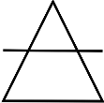
Common Traditions Culture, Philosophy, and Religion
Elements of Nature
Fire
Earth
Wind
Water
Spirit – a.k.a. Aether or “breath of life”

Slide 3
Common Traditions Culture, Philosophy, and Religion
Order of Creative Events
1. Formation of the Earth
2. Life in the Oceans
3. Life on Land
4. Humankind
* life in the air varies by tradition (birds)

Slide 4
Geologic History
The Story of Everything
Part 2 Scientific Theories

Slide 5
Scientific Theories Empirical Evidence
Fossils
Process of formation
Dating techniques – relative vs. radiometric

Slide 6
Scientific Theories Empirical Evidence
Geology
Plate tectonics
Rock cycle

Slide 7
Scientific Theories Empirical Evidence
Astronomy
Spectroscopy
Red/Blue shift
CBMR
Telescopy

Slide 8
Scientific Theories Fossils, Geology, and Astronomy – Empirical Evidence
Ingredients for a Living Planet
Stable Source of Energy
Active Geosphere
Active Hydrosphere
Active Atmosphere
Balanced Biosphere

Slide 9
Scientific Theories Cycling of Matter and Energy
Energy Sources and Interactions
1. Solar Energy (Radiation, Light, Heat)
2. Earth’s Hot Core (Radiation/Gravity)
3. Gravity (Sun-Earth-Moon System - Seasons)
4. Uneven Heating of Materials
∙ Climate Zones (Curvature Surface)
∙ Convection (Air, Land, Sea, Core)

Slide 10
Scientific Theories Cycling of Matter and Energy
Geosphere
1. Convection Currents in the Mantle (Magma)
2. Volcanic Activity
3. Plate Tectonics
4. Rock Cycle

Slide 11
Scientific Theories Cycling of Matter and Energy
Hydrosphere
1. Deep Ocean Currents (Convection)
2. Surface Ocean Currents (Prevailing Winds)
2. Tides (Gravity of Sun and Moon)
3. Water Cycle
a. Evaporation, Condensation, Precipitation
b. Surface and Ground Water
c. Polar Ice Caps

Slide 12
Scientific Theories Cycling of Matter and Energy
Atmosphere
1. Air Currents (Convection, Coriolis Effect)
2. Weather (Air Pressure, Precipitation, Temperature)
3. Climate (Average Weather)
4. Greenhouse Effect (Thermal Shield)
5. Ozone Layer (Radiation Shield)

Slide 13
Scientific Theories Cycling of Matter and Energy
Biosphere
1. Biogeochemical Cycles ( H₂O, O₂ , CO₂ , N₂, S, P)
2. Cycles of Environmental Change,
Evolution, Adaptation, and Extinctions
3. Balanced Ecosystems
4. Population Dynamics
5. Trophic Levels, Food Webs, and Energy Pyramids

Slide 14
Geologic History
The Story of Everything
Part 3 Timeline of the Story

Slide 15
Cosmic Timeline Divisions and Units of Measure
Eons
1,000’s of Millions of Years
Eras
100’s of Millions of Years
Periods
10’s of Millions of Years
Epochs
Millions of Years

Slide 16
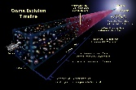
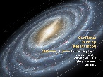
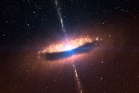
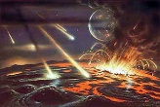
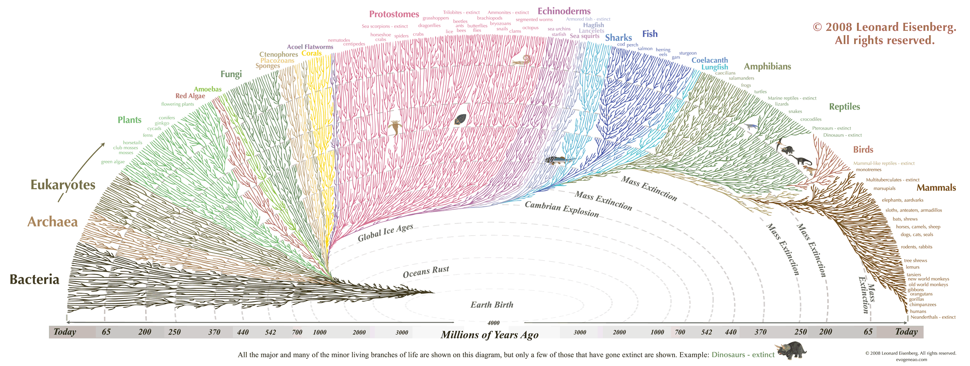
Geologic Timeline Eons of Cosmic History
Cosmic Evolution
Galactic Evolution
Stellar Evolution
Planetary Evolution
Biological Evolution

Slide 17
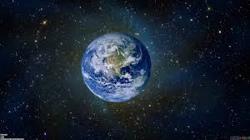
Geologic Timeline Eons of Earth’s History
Hadean
1 Billion Years
Archean
1 Billion Years
Proterozoic
2 Billion Years
Phanerozoic
½ Billion Years

Slide 18
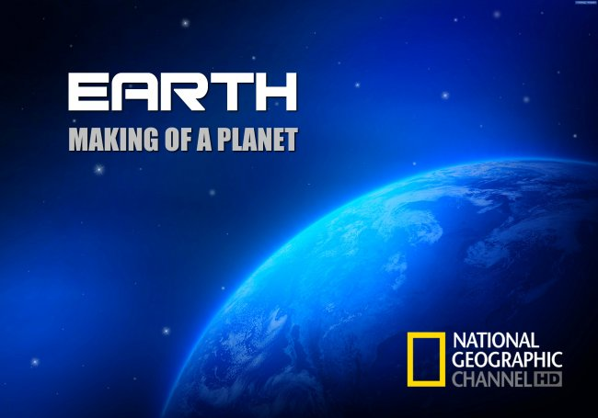
Geologic Timeline Eons of Earth’s History
Hadean Eon
Archean
Proterozoic
Phanerozoic
Video: Earth – Making of a Planet

Slide 19
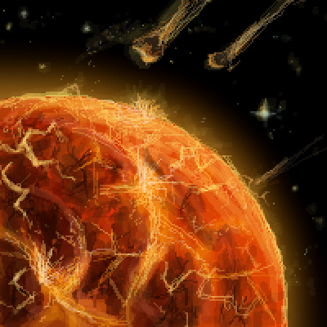
Geologic Timeline Eons of Earth’s History
Hadean Eon
Archean
Proterozoic
Phanerozoic
· Meaning: “Hell on Earth”
· Began: ~ 5 Billion Years Ago
· Length: ~ 1 Billion Years
· Birth of Solar System & Accretion of Planets
· Theia Event – Formation of the Moon
· 1st Atmosphere, Cooling Temperatures,
Crust Forms, Oceans Fill, Continents Drift

Slide 20
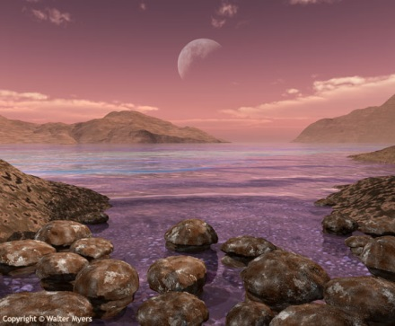
Geologic Timeline Eons of Earth’s History
Hadean Eon
Archean
Proterozoic
Phanerozoic
· Meaning: “Beginning or Origin” of Life
· Began: ~ 3.8 Billion Years Ago
· Length: ~ 1 Billion Years
· Natural Development of Organic Molecules
in Deep Water and Shallow Pools
· First Single Cell Prokaryotes
· Chemosynthesis vs. Photosynthesis

Slide 21
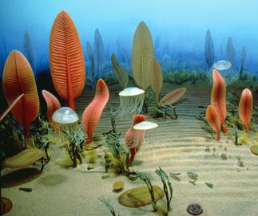
Geologic Timeline Eons of Earth’s History
Hadean Eon
Archean
Proterozoic
Phanerozoic
· Meaning: “Earlier Life”
· Began: ~ 2.5 Billion Years Ago
· Length: ~ 2 Billion Years
· Snowball Earth Event
· Oxygenation Event
· Early Multicellular Forms of Life

Slide 22
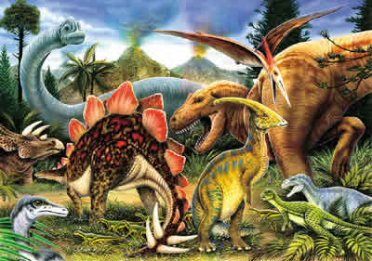
Geologic Timeline Eons of Earth’s History
Hadean Eon
Archean
Proterozoic
Phanerozoic
· Meaning: “Visible Life”
· Began: ~ ½ Billion Years Ago (Ongoing)
· Cambrian Explosion – Diversity of Species
· Advanced Plants and Animals in Oceans
· Migration of Life to Land

Slide 23
Geologic History
Making of a Planet
Part 4 Phanerozoic Eon
Hadean, Archean, Proterozoic, PHANEROZOIC

Slide 24
PHANEROZOIC EON
Paleozoic Era
Mesozoic Era
Cenozoic Era
Means “old life”
Began about 541 Mya
Major Evolutionary Events Include:
Central Nervous System + Eyes
Skeletons in Fish
Spinal Cord + Vertebral Column
Wings in Insects
Plant Life Migrates to Land
(Vascular Tissue, Spores in Ferns)
Amniotic Eggs in Reptiles
Reptiles Migrate to Land
Insects Migrate to Land
Mammal-Like Reptiles Appear
Jaw Structures in Fish
Seeds in Plants
Amphibians Migrate to Land
(Tetrapods)
Paleozoic Era Ended in Mass Extinction – 95% of All Species

Slide 25
PHANEROZOIC EON
Paleozoic Era
Mesozoic Era
Cenozoic Era
Means “middle life”
Began about 251 Mya
Major Evolutionary Events Include:
Conifer Forests Spread
Birds Appear
First Mammals & Dinosaurs Appear
Flying Reptiles
Turtles, Frogs, Lizards, and Salamanders Appear
Flowers and Fruit in Plants
Wings in Insects
Dinosaurs Dominate
Mesozoic Era Ended in Mass Extinction – Asteroid Strike – 50%

Slide 26
PHANEROZOIC EON
Paleozoic Era
Mesozoic Era
Cenozoic Era
Means “new life”
Began about 66 Mya
Major Evolutionary Events Include:
Mammals Survive and Dominate
Flowering Plants Dominate
Grasses Appear and Spread
Four Major Glaciation Periods
· Extinction of Large Mammals
· Rapid Changes in Marine Species
Several Species of Humans Appear and Go Extinct

Slide 27
Geologic History
Making of a Planet
Part 5 Patterns of Evolution

Slide 28
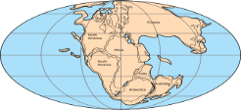
Patterns of Evolution Geological
Continental Drift and Supercontinents
Ur (Vaalbara)
~ 3.6 Gya (Archean)
Kenorland
~ 2.7 Gya (Archean)
Columbia (Nuna)
~ 1.8 Gya (Proterozoic)
Rodinia
~ 1.3 Gya (Proterozoic)
Pannotia
~ 600 Mya (Proterozoic)
Pangaea
~ 300 Mya (Phanerozoic)

Slide 29
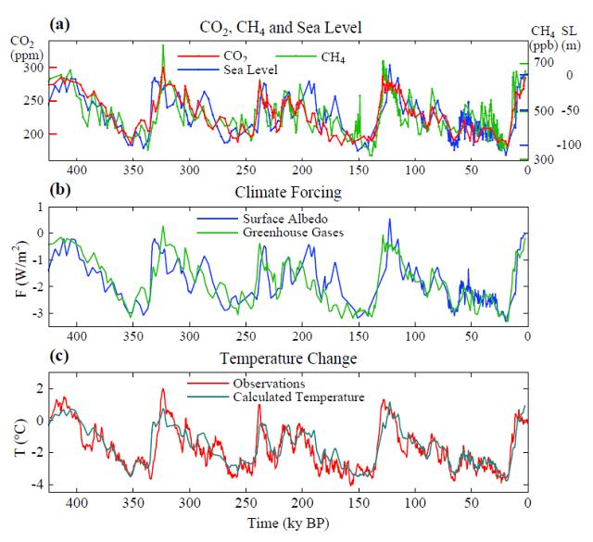
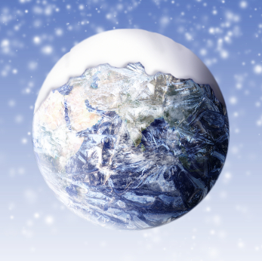
Patterns of Evolution Geological
Global Warming/Cooling
Glaciers and Polar Ice Caps
Changes in Sea Level
Ice Ages

Slide 30
Patterns of Evolution Biological
Environmental Changes & Mass Extinctions
Genetic Mutations
1. Random and Require Many Generations
2. Most Mutations are Deadly – Lead to Extinction
3. Diversification in Anatomy and Physiology
4. Diversification in Size
5. Best Adaptations Passed On to Posterity

Slide 31
Geologic History
The Story of Everything
Part 6 Human Evolution

Slide 32
Human Evolution Links to More Information from the Smithsonian
Human Evolution Family Tree [link]
Human Evolution Timeline [link]
All Human Species [link]
Human Genetics [link]

Slide 33
What Comes Next? Based on patterns of past events…
What planetary changes or natural disasters might happen to Earth in the future?
How would environmental changes affect life forms in various biomes?
How might humans change (parts/sizes/behaviors) due to random genetic mutations?
If homo sapiens do not go extinct, might our species diversify into many new species of humans?
Now that we have science and technology, might we take control of our own evolution?

Slide 34
fin?

Slide 35
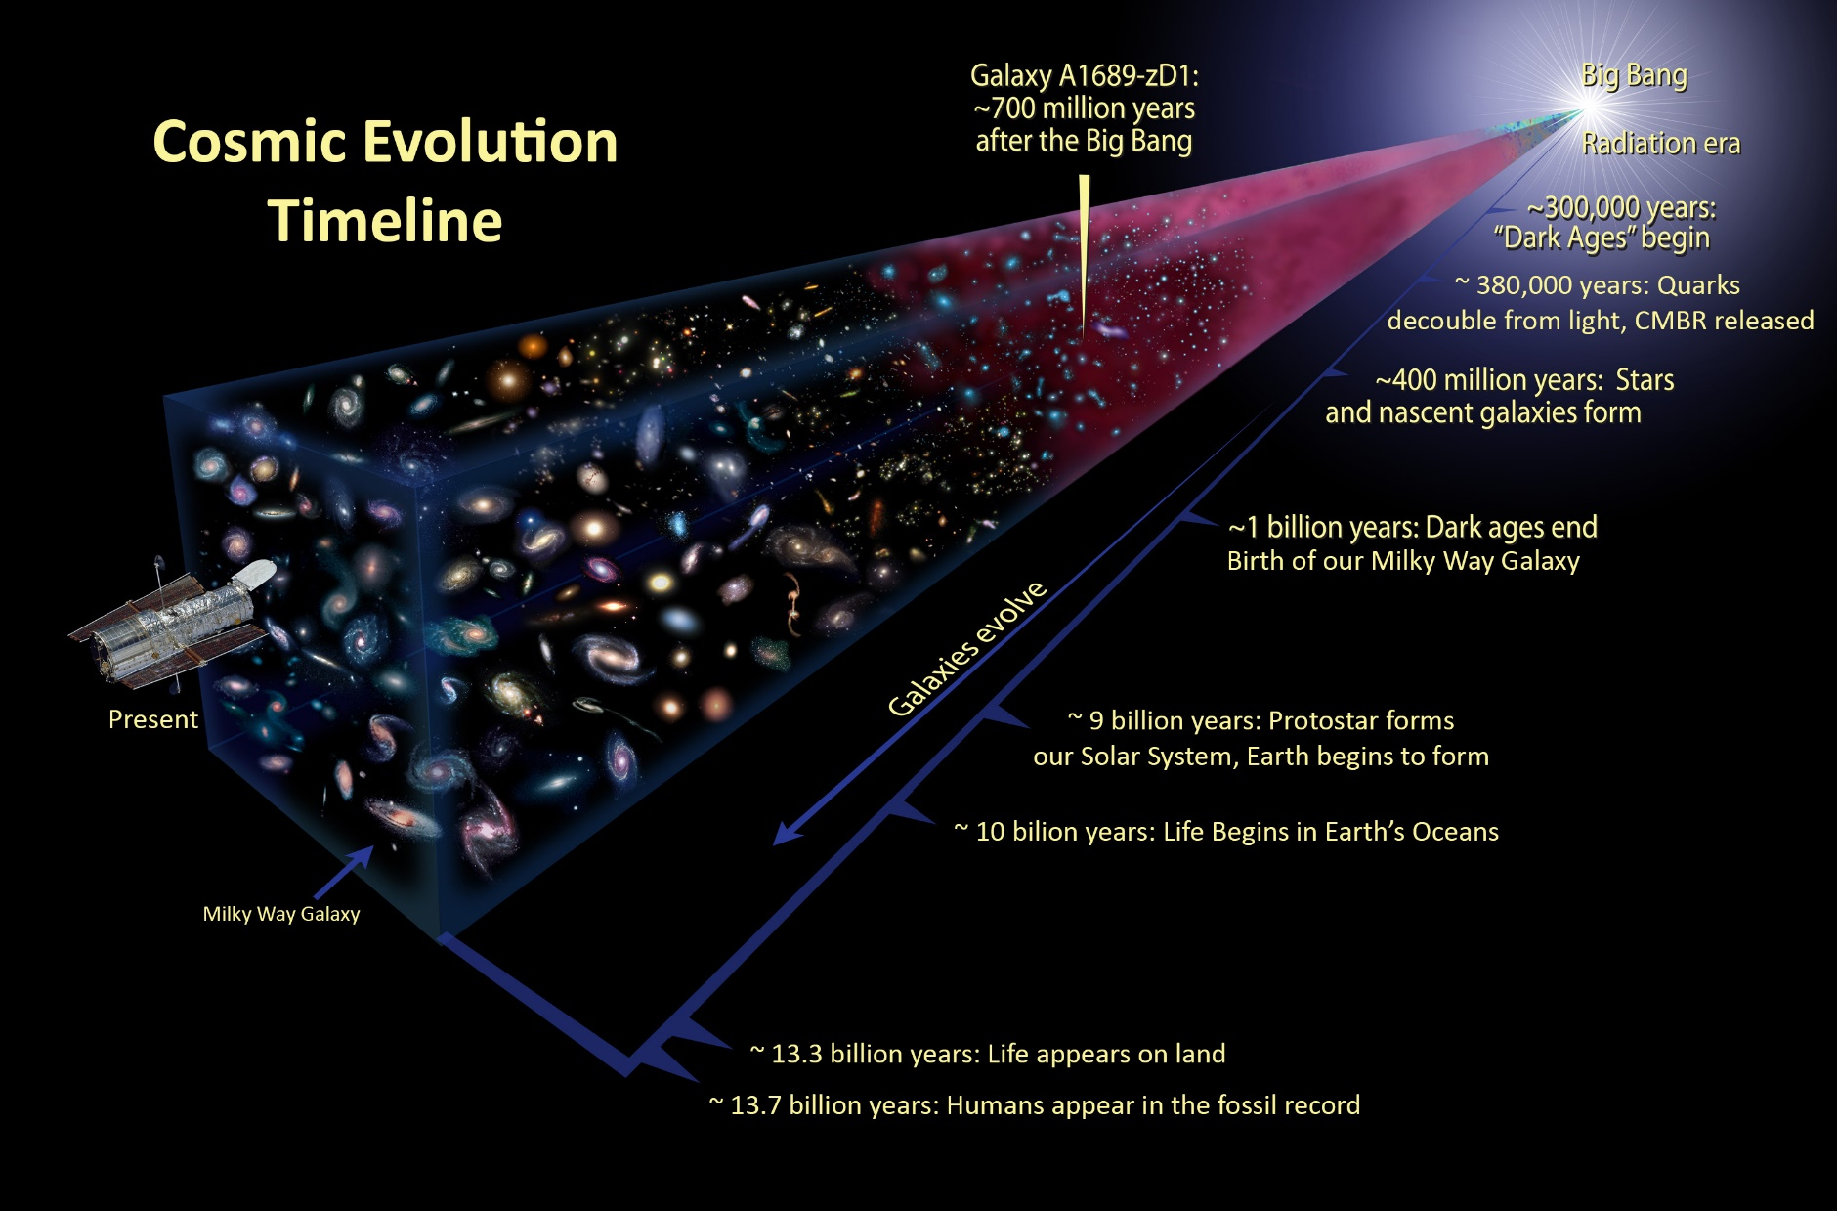
Back

Slide 36
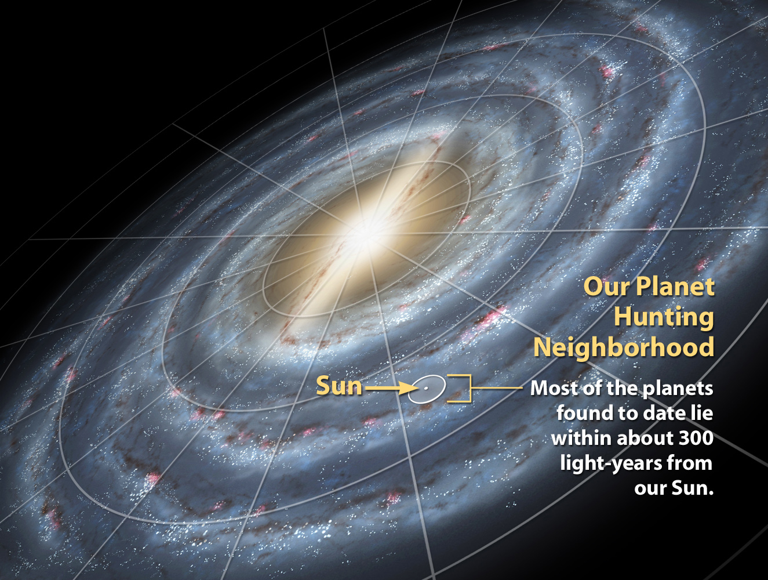
Back

Slide 37
Back

Slide 38
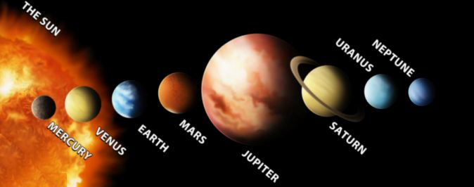
Back

Slide 39
Back

