Slide 1
Geologic History
The Story of Everything
Part 1 Common Traditions
2017

Slide 2
Common Traditions
Culture, Philosophy, and Religion
Human civilizations throughout history have created stories to explain the origin of the world and life upon it.
These creation myths† demonstrate remarkably intelligent observations of our surroundings and natural phenomena.
Creation myths agree more closely to scientific theories than many people are willing to admit.
† From ancient Greek muthos, “report,” “tale,” “story.” Modern English mythos, a story or set of stories which have a significant truth or meaning for a particular culture, religion, society, or other group. This word is not meant to be insulting to anyone.
“And some things that should not have been forgotten were lost. History became legend. Legend became myth.” – Galadriel

Slide 3
Common Traditions
Culture, Philosophy, and Religion
Creation Myth Categories†
Ex Nihlo (L. “from nothing”) or from primeval abyss (infinite expanse of waters/space) – creation is the result of thoughts, words, dreams, or bodily secretions of a divine being (deity) who is poised above the abyss
Earth Diver – a messenger (usually bird or amphibian) from a creator, plunges into a seabed to bring up material to form the terrestrial world
Emergence – progenitors pass through a series of worlds and metamorphoses until reaching the present state of existence
Dismemberment - life generated from the corpse or dismembered parts of a primordial deity (often paired with natural cycles and seasons)
Monism (all things are “one”) - the universe is a primordial unity that has been split and ordered
† Eliade, Long, Over, Weigle

Slide 4


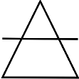


Common Traditions
Culture, Philosophy, and Religion
Classic Elements of Nature (Greek) – These have become such an embedded part of language and culture that the ideas continue to influence how we think. They represent categories of substances or divisions of nature.
Fire
Earth
Wind
Water
Spirit/Aether, “breath of life”

Slide 5
Common Traditions
Culture, Philosophy, and Religion
Order of Creative Events – The Most Common Traditions
Christian, Muslim, Jewish (>50% of all humans)
1. Formation of the Earth
2. Life in the Oceans
3. Life on Land
4. Humans
* life in the air varies by tradition (birds)

Slide 6
Geologic History
The Story of Everything
Part 2 Scientific Theories

Slide 7
Scientific Theories
Empirical Evidence
Evolution of the Universe
  Big Bang & Expansion of the Cosmos
  Telescopic Astronomy & Spectroscopy
  Red/Blue Shift & Universal Expansion
  Big Bang Energy Dissipation & CBMR
  Universal Abundance of Elements
  Olber’s Paradox

Slide 8
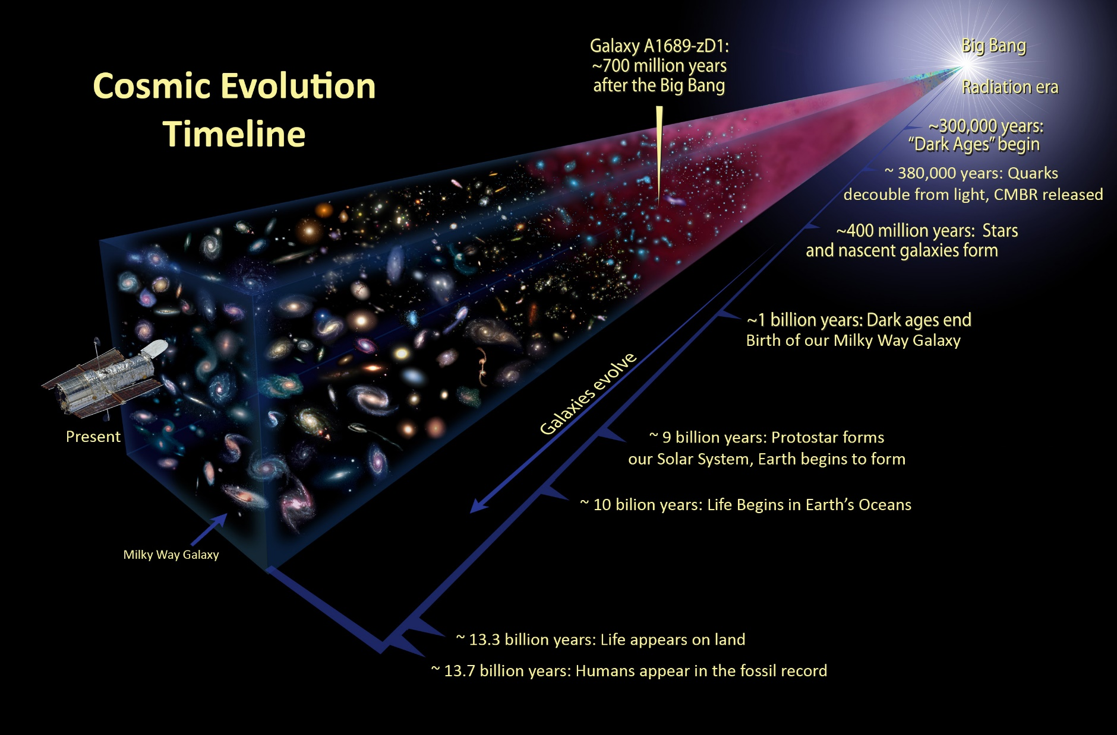
What is the future of our Universe?

Slide 9
Scientific Theories
Empirical Evidence
Galactic & Stellar Evolution
  Telescopic Astronomy & Spectroscopy
  Gravitational Condensation of H₂ and He
  Fusion & Generation of Heavier Elements
  Recycling of Matter and Energy

Slide 10
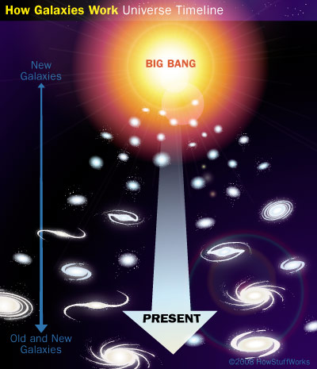

Slide 11
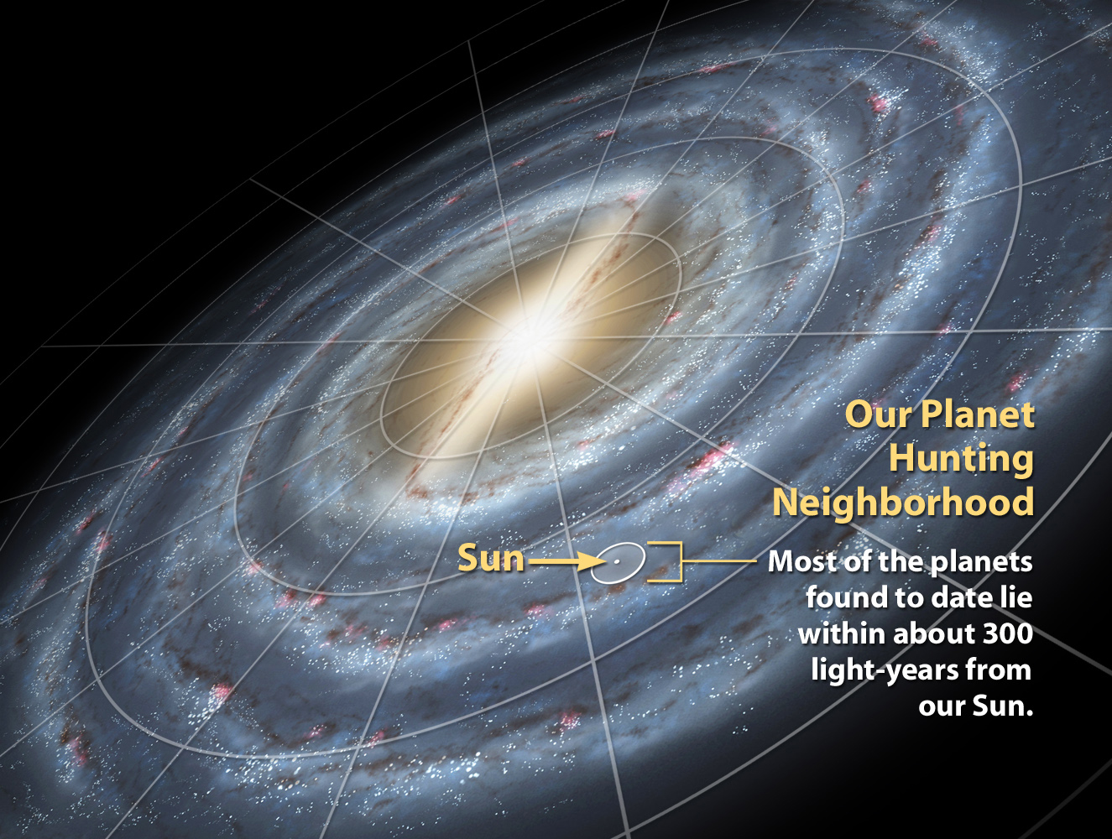
Our Milky Way Galaxy

Slide 12
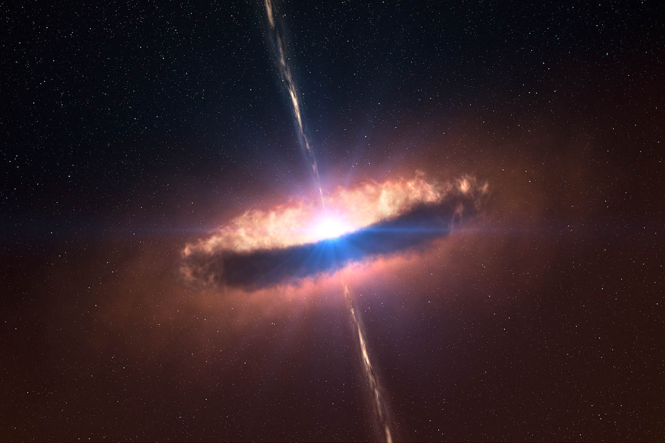
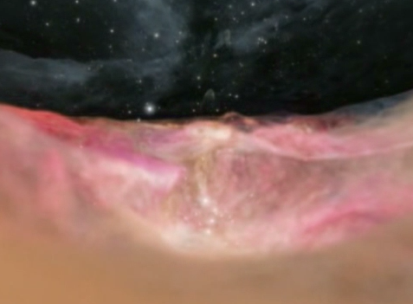
Nebular Theory: Birth of a Star
“stellar disk”
IMAX Hubble Video
Nuclear fusion ignited by gravitational pressure at center of accretion disk

Slide 13
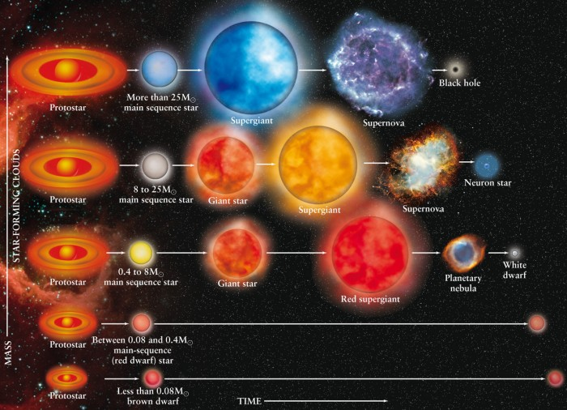
Stellar
Life Cycles
Sol

Slide 14
Scientific Theories
Empirical Evidence
Planetary Evolution
  Planetary accretion around stellar disks
  Geology - rock cycles and core samples
  (materials from the Moon, Mars, and Meteorites)
  Core samples of ice (atmospherics)

Slide 15
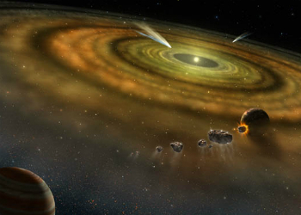
baby star
Orbiting dust particles gather by gravity into rings that accrete into planets

Slide 16
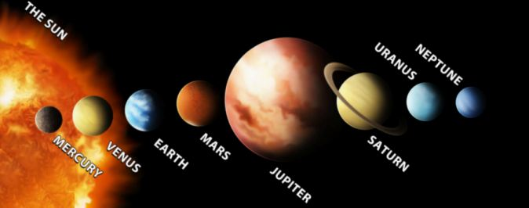
Our Stellar System - Sol

Slide 17
Scientific Theories
Empirical Evidence
Biological Evolution
  Fossils & Age Dating – relative vs. radiometric
  Homologous Structures
  Embryonic Similarities
  Species Test Crosses
  Phylogenetics (DNA code similarities)

Slide 18
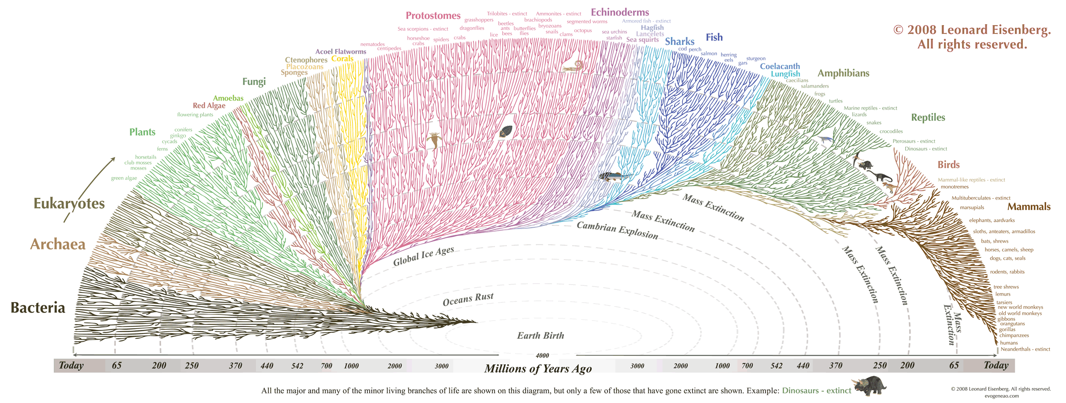
Biological Evolutionary Tree
zoom

Slide 19
Scientific Theories
Fossils, Geology, and Astronomy – Empirical Evidence
Ingredients for a Planet with Life
Stable Source of Energy
Active Geosphere
Active Hydrosphere
Active Atmosphere
Balanced Biosphere

Slide 20
Scientific Theories
Cycling of Matter and Energy
Energy Sources and Interactions
1. Solar Energy (Radiation, Light, Heat)
2. Earth’s Hot Core (Radiation/Gravity)
3. Gravity (Sun-Earth-Moon System - Seasons)
4. Uneven Heating of Materials
∙ Climate Zones (Curvature Surface)
∙ Convection (Air, Land, Sea, Core)

Slide 21
Scientific Theories
Cycling of Matter and Energy
Geosphere
1. Convection Currents in the Mantle (Magma)
2. Volcanic Activity
3. Plate Tectonics
4. Rock Cycle

Slide 22
Scientific Theories
Cycling of Matter and Energy
Hydrosphere
1. Deep Ocean Currents (Convection)
2. Surface Ocean Currents (Prevailing Winds)
3. Tides (Gravity of Sun and Moon)
4. Water Cycle
a. Evaporation, Condensation, Precipitation
b. Surface and Ground Water
c. Polar Ice Caps

Slide 23
Scientific Theories
Cycling of Matter and Energy
Atmosphere
1. Air Currents (Convection, Coriolis Effect)
2. Weather (Air Pressure, Precipitation, Temperature)
3. Climate (Average Weather)
4. Greenhouse Effect (Thermal Shield)
5. Ozone Layer (Radiation Shield)

Slide 24

Scientific Theories
Cycling of Matter and Energy
Biosphere
1. Biogeochemical Cycles ( H₂O, O₂ , CO₂ , N₂, S, P)
2. Cycles of Environmental Change,
Evolution, Adaptation, and Extinctions
3. Balanced Ecosystems
4. Population Dynamics
5. Trophic Levels, Food Webs, and Energy Pyramids

Slide 25
Geologic History
The Story of Everything
Part 3 Timeline of the Story

Slide 26
Cosmic Timeline
Divisions and Units of Measure
Eons
1000’s of millions of years (billions)
Eras
100’s of millions of years
Periods
10’s to 100 million years
Epochs
10’s of millions of years
Ages
millions of years
Millennia
thousands of years
Centuries
hundreds of years
Decades
tens of years

Slide 27
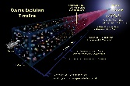
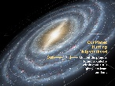

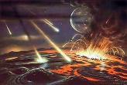
Geologic Timeline
Scales / Contexts of Evolution
Cosmic Evolution
Galactic Evolution
Solar Evolution
Planetary Evolution
Biological Evolution

Slide 28
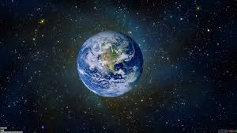
Geologic Timeline
Eons of Earth’s Planetary/Biological Evolution
Hadean
1 Billion Years
Archean
1 Billion Years
Proterozoic
2 Billion Years
Phanerozoic
½ Billion Years

Slide 29
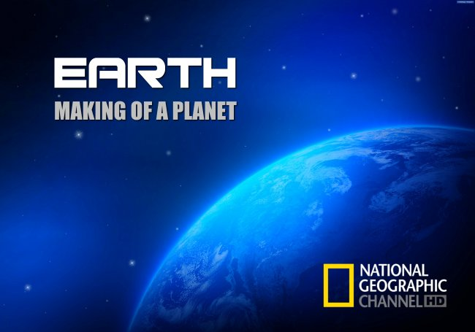
Geologic Timeline
Eons of Earth’s History
Hadean Eon
Archean
Proterozoic
Phanerozoic
Video: Earth – Making of a Planet

Slide 30
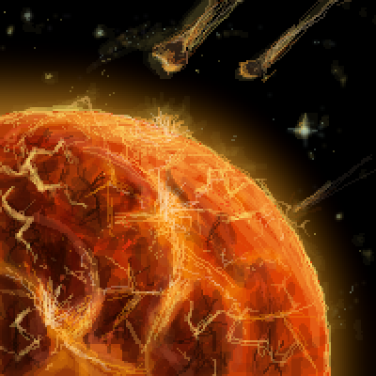
Geologic Timeline
Eons of Earth’s History
Hadean Eon
Archean
Proterozoic
Phanerozoic
· Meaning: “Hell on Earth”
· Began: ~ 5 Billion Years Ago
· Length: ~ 1 Billion Years
· Birth of Solar System & Accretion of Planets
· Theia Event – Formation of the Moon
· 1st Atmosphere, Cooling Temperatures,
Crust Forms, Oceans Fill, Continents Drift

Slide 31
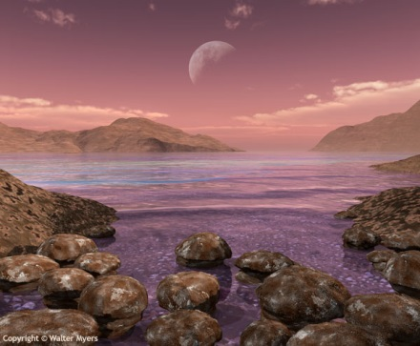
Geologic Timeline
Eons of Earth’s History
Hadean Eon
Archean
Proterozoic
Phanerozoic
· Meaning: “Beginning or Origin” of Life
· Began: ~ 3.8 Billion Years Ago
· Length: ~ 1 Billion Years
· Natural Development of Organic Molecules
in Deep Water and Shallow Pools
· First Single Cell Prokaryotes
· Chemosynthesis vs. Photosynthesis

Slide 32
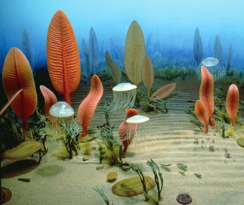
Geologic Timeline
Eons of Earth’s History
Hadean Eon
Archean
Proterozoic
Phanerozoic
· Meaning: “Earlier Life”
· Began: ~ 2.5 Billion Years Ago
· Length: ~ 2 Billion Years
· Snowball Earth Event
· Oxygenation Event
· Early Multicellular Forms of Life

Slide 33
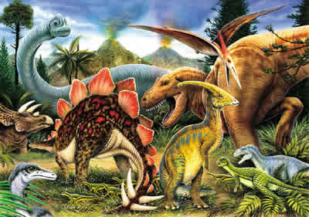
Geologic Timeline
Eons of Earth’s History
Hadean Eon
Archean
Proterozoic
Phanerozoic
· Meaning: “Visible Life”
· Began: ~ ½ Billion Years Ago (Ongoing)
· Cambrian Explosion – Diversity of Species
· Advanced Plants and Animals in Oceans
· Migration of Life to Land

Slide 34
Geologic History
Making of a Planet
Part 4 Phanerozoic Eon
Hadean, Archean, Proterozoic, PHANEROZOIC

Slide 35
PHANEROZOIC EON
Paleozoic Era
Mesozoic Era
Cenozoic Era
Means “old life”
Began about 541 Mya
Major Evolutionary Events Include:
Central Nervous System + Eyes
Skeletons in Fish
Spinal Cord + Vertebral Column
Wings in Insects
Plant Life Migrates to Land
(Vascular Tissue, Spores in Ferns)
Amniotic Eggs in Reptiles
Reptiles Migrate to Land
Insects Migrate to Land
Mammal-Like Reptiles Appear
Jaw Structures in Fish
Seeds in Plants
Amphibians Migrate to Land
(Tetrapods)
Paleozoic Era Ended in Mass Extinction – 95% of All Species

Slide 36
PHANEROZOIC EON
Paleozoic Era
Mesozoic Era
Cenozoic Era
Means “middle life”
Began about 251 Mya
Major Evolutionary Events Include:
Conifer Forests Spread
Birds Appear
First Mammals & Dinosaurs Appear
Flying Reptiles
Turtles, Frogs, Lizards,
and Salamanders Appear
Flowers and Fruit in Plants
Wings in Insects
Dinosaurs Dominate
Mesozoic Era Ended in Mass Extinction – Asteroid Strike – 50%

Slide 37

PHANEROZOIC EON
Paleozoic Era
Mesozoic Era
Cenozoic Era
Means “new life”
Began about 66 Mya
Major Evolutionary Events Include:
Mammals Survive and Dominate
Flowering Plants Dominate
Grasses Appear and Spread
Four Major Glaciation Periods
· Extinction of Large Mammals
· Rapid Changes in Marine Species
Several Species of Humans Appear and Go Extinct

Slide 38
Geologic History
Making of a Planet
Part 5 Patterns of Evolution

Slide 39
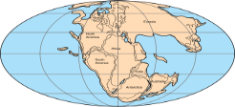
Patterns of Evolution
Geological
Continental Drift and Supercontinents
Ur (Vaalbara)
~ 3.6 Gya (Archean)
Kenorland
~ 2.7 Gya (Archean)
Columbia (Nuna)
~ 1.8 Gya (Proterozoic)
Rodinia
~ 1.3 Gya (Proterozoic)
Pannotia
~ 600 Mya (Proterozoic)
Pangaea
~ 300 Mya (Phanerozoic)

Slide 40
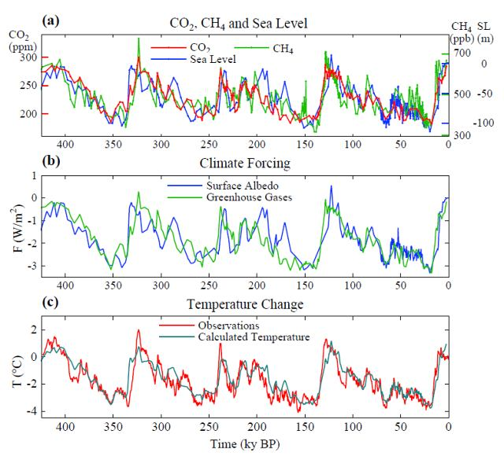
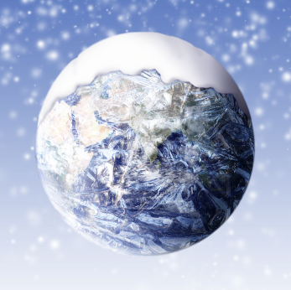
Patterns of Evolution
Geological
Global Warming/Cooling
Glaciers and Polar Ice Caps
Changes in Sea Level
Ice Ages

Slide 41
Patterns of Evolution
Biological
Environmental Changes & Mass Extinctions
Genetic Mutations
1. Random and Require Many Generations
2. Most Mutations are Deadly – Lead to Extinction
3. Diversification in Anatomy and Physiology
4. Diversification in Size
5. Best Adaptations Passed On to Posterity

Slide 42
Geologic History
The Story of Everything
Part 6 Human Evolution

Slide 43
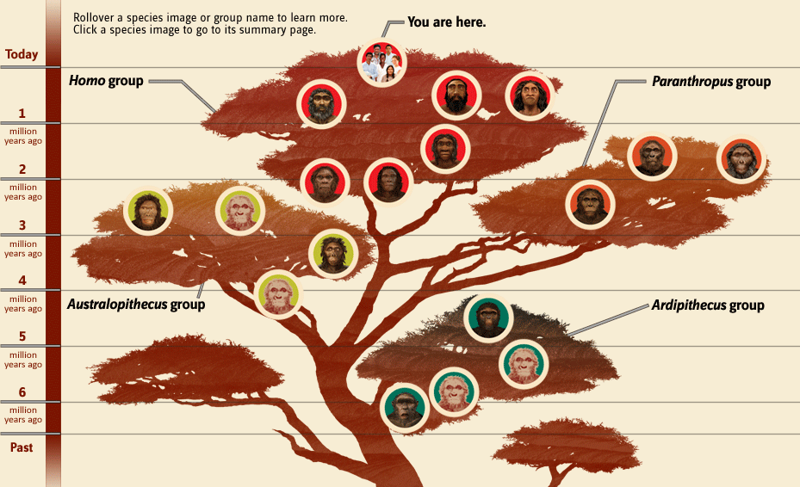
Human Evolution
Smithsonian National Museum of Natural History
What does it mean to be human?

Slide 44
What Comes Next?
Based on patterns of past events…
What planetary changes or natural disasters might happen to Earth in the future?
How would environmental/climate changes affect life forms in various biomes?
If homo sapiens do not go extinct, might our species branch into several new species of humans?
How might human species change (parts/sizes/behaviors)?
Now that we have science and technology, HOW might we take control of our own evolution?

Slide 45
fin?

